Slide 1
HRIA in the Agriculture Sector
Kendyl Salcito
NomoGaia
HRIA Workshop 17 Nov 2016

Slide 2
Case Studies
Land Tenure Insecurity
Post-Conflict Instability
Labor Rights
Environmental Rights
Supply Chain Links

Slide 3
Access Documents Online
Dole Costa Rica Pineapple HRIA
KLK Liberia Palm Oil HRIA
Green Resources Tanzania Pine HRIA
Methodology
http://nomogaia.org/2010/12/dole-fresh-fruit-hria-sample/
http://nomogaia.org/2016/10/equatorial-palm-oil-hrra/
http://nomogaia.org/2009/10/green-resources-uchinidle-tree-farm-tanzania/
http://nomogaia.org/tools/

Slide 4
Planning for HRIA
Screening
Contextual Challenges
Operational Footprint
Scoping
Social Tensions
Governance
Field-based HRIA
Acquire perspectives of rightsholders & stakeholders
Score & Rate Impacts
Labor
Security
Public Participation
Mitigation Action Plan
Prioritize interventions
Management and Monitoring
Industry Issues
Create timelines and benchmarks
Aggregated quantitative and qualitative data
Identify misalignment between policy & practice

Slide 5
Planning for HRIA
Screening
Contextual Challenges
Operational Footprint
Scoping
Social Tensions
Governance
Field-based HRIA
Acquire perspectives of rightsholders & stakeholders
Score & Rate Impacts
Labor
Security
Public Participation
Mitigation Action Plan
Prioritize interventions
Management and Monitoring
Industry Issues
Create timelines and benchmarks
Aggregated quantitative and qualitative data
Identify misalignment between policy & practice

Slide 6
SCREENING
Screening
Contextual Challenges
Operational Footprint
Scoping
Field-based HRIA
Management and Monitoring
Industry Issues
Mitigation Action Plan
Context
Operation
Industry
Conflict/ Post-Conflict
Weak Governance
Low Income
Indigenous/ Marginalized Populations
Capital-Intensive
Resource-Related
Land-Intensive
Labor-Intensive

Slide 7
SCREENING Green Resources Tanzania
Screening
Contextual Challenges
Operational Footprint
Scoping
Field-based HRIA
Management and Monitoring
Industry Issues
Mitigation Action Plan
Context
Operation
Industry
Conflict/ Post-Conflict
Weak Governance
Low Income
Indigenous/ Marginalized Populations
Capital-Intensive
Resource-Related
Land-Intensive
Labor-Intensive

Slide 8
SCREENING KLK Palm Oil Liberia
Screening
Contextual Challenges
Operational Footprint
Scoping
Field-based HRIA
Management and Monitoring
Industry Issues
Mitigation Action Plan
Context
Operation
Industry
Conflict/ Post-Conflict
Weak Governance
Low Income
Indigenous/ Marginalized Populations
Capital-Intensive
Resource-Related
Land-Intensive
Labor-Intensive

Slide 9
SCREENING Dole Fruit Costa Rica
Screening
Contextual Challenges
Operational Footprint
Scoping
Field-based HRIA
Management and Monitoring
Industry Issues
Mitigation Action Plan
Context
Operation
Industry
Conflict/ Post-Conflict
Weak Governance
Low Income
Indigenous/ Marginalized Populations
Capital-Intensive
Resource-Related
Land-Intensive
Labor-Intensive

Slide 10
Planning for HRIA
Screening
Contextual Challenges
Operational Footprint
Scoping
Social Tensions
Governance
Field-based HRIA
Acquire perspectives of rightsholders & stakeholders
Score & Rate Impacts
Labor
Security
Public Participation
Mitigation Action Plan
Prioritize interventions
Management and Monitoring
Industry Issues
Create timelines and benchmarks
Aggregated quantitative and qualitative data
Identify misalignment between policy & practice

Slide 11
Scoping
Category | Rights Topics
Labor | 34 Indicators
Health | 49 Indicators
Environment | 63 Indicators
Political/ Legal | 37 Indicators
Economic/ Cultural/ Social | 51 Indicators
Screening
Scoping
Field-based HRIA
Management and Monitoring
Mitigation Action Plan
Labor
Health
Env
Political
Econ/ Soc/Cult

Slide 12
Planning for HRIA
Screening
Contextual Challenges
Operational Footprint
Scoping
Social Tensions
Governance
Field-based HRIA
Acquire perspectives of rightsholders & stakeholders
Score & Rate Impacts
Labor
Security
Public Participation
Mitigation Action Plan
Prioritize interventions
Management and Monitoring
Industry Issues
Create timelines and benchmarks
Aggregated quantitative and qualitative data
Identify misalignment between policy & practice

Slide 13
Field-based HRIA
Screening
Scoping
Field-based HRIA
Management and Monitoring
Mitigation Action Plan
Aggregated data
Acquire Righst-holder Views
Identify Gaps
Rate Impacts
Aggregate Data
Cataloging and interviewing
Acquiring Rightsholder Views
Train your guide
Plan a sampling Strategy
Test your questions
Identifying Gaps
Triangulation
Rating Impacts
Scoring process

Slide 14
Field-based HRIA
Screening
Scoping
Field-based HRIA
Management and Monitoring
Mitigation Action Plan
Aggregated data
Acquire Righst-holder Views
Identify Gaps
Rate Impacts
Aggregate Data
Cataloging and interviewing
Acquiring Rightsholder Views
Train your guide
Plan a sampling Strategy
Test your questions
Identifying Gaps
Triangulation
Rating Impacts
Scoring process

Slide 15
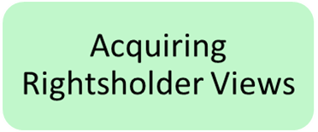
Field-based HRIA
Acquiring Rightsholder Views
Training guides/translators
Testing questions
Planning a sampling strategy

Slide 16
Rightsholder Engagement
Engagement Hacks
Being:
Available
Inconvenient to ignore
Innocuous
Unburdensome

Slide 17
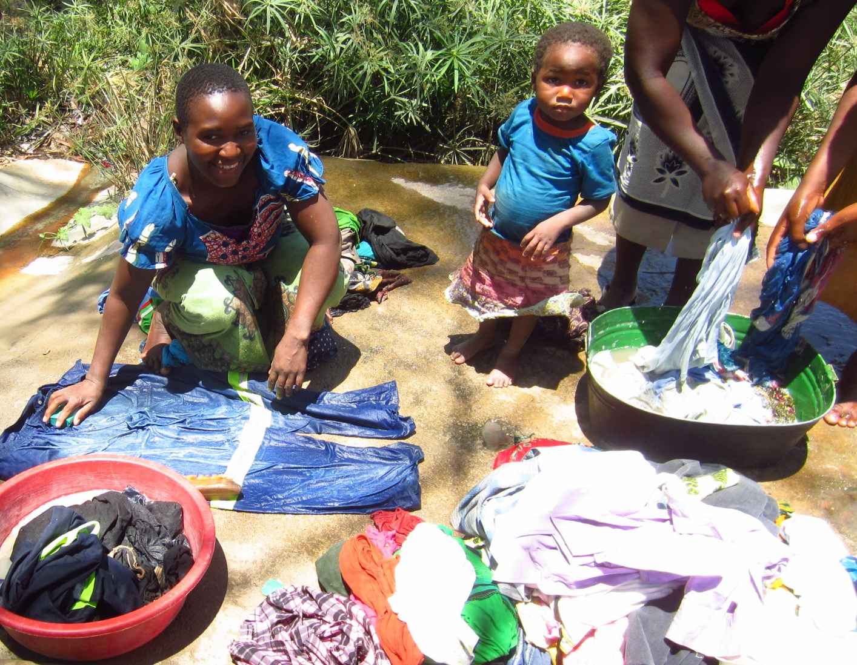
Rightsholder Engagement
Engagement Hacks
Being:
Available
Inconvenient to ignore
Innocuous
Unburdensome

Slide 18
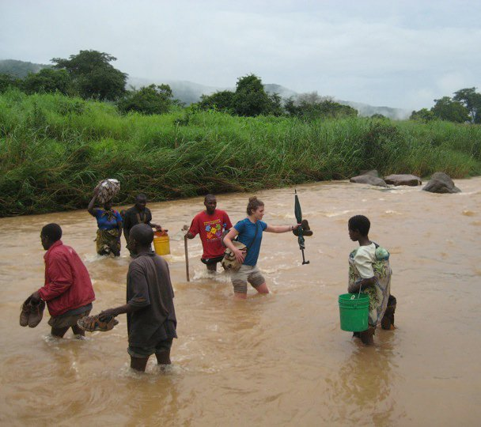
Rightsholder Engagement
Engagement Hacks
Being:
Available
Inconvenient to ignore
Innocuous
Unburdensome

Slide 19
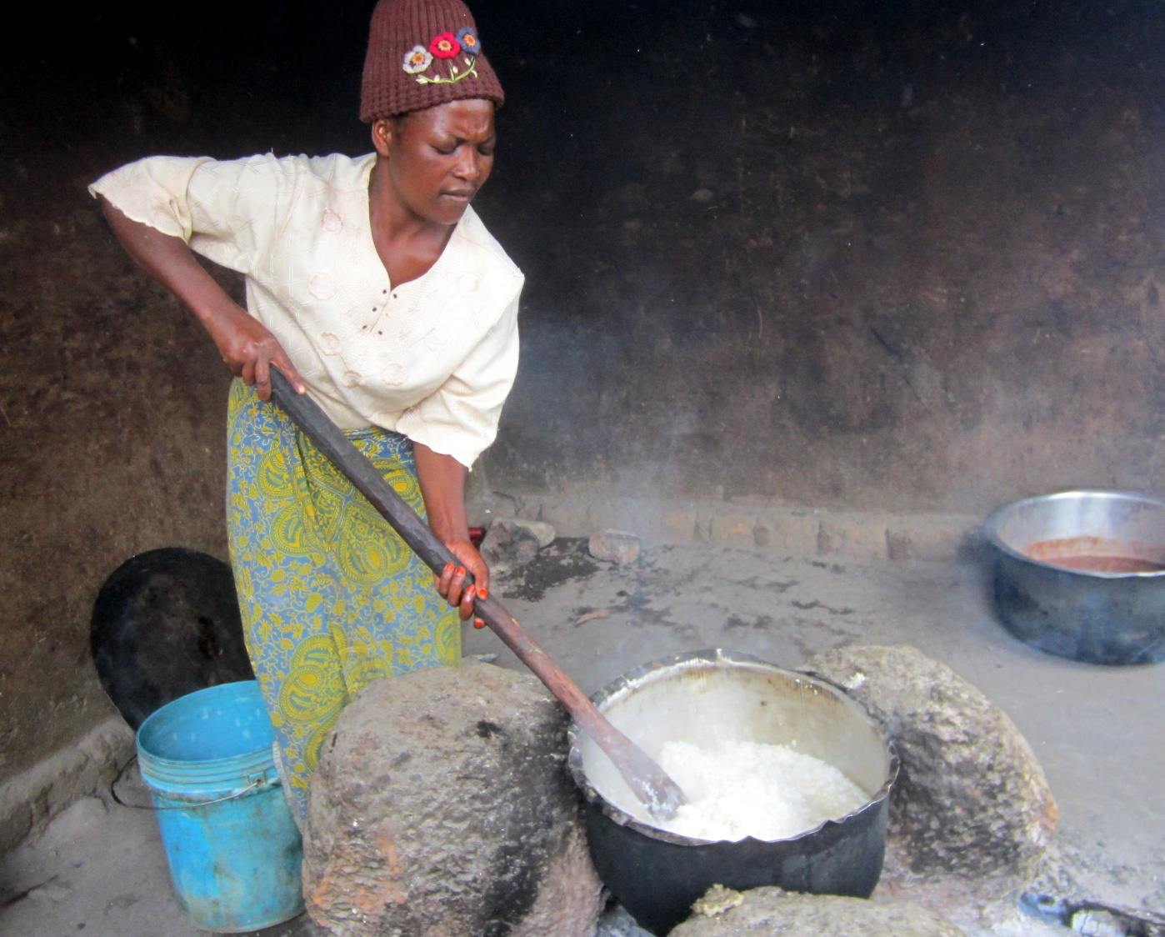
Rightsholder Engagement
Engagement Hacks
Being:
Available
Inconvenient to ignore
Innocuous
Unburdensome

Slide 20
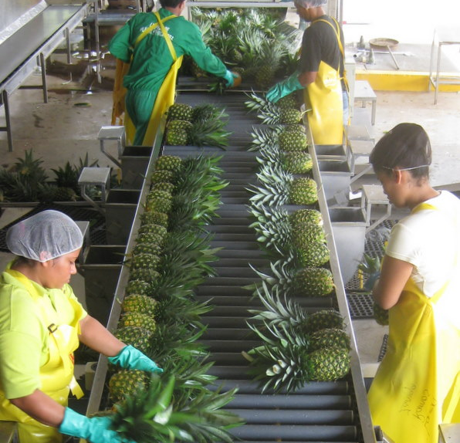
Rightsholder Engagement
Engagement Hacks
Being:
Available
Inconvenient to ignore
Innocuous
Unburdensome

Slide 21
Field-based HRIA
Screening
Scoping
Field-based HRIA
Management and Monitoring
Mitigation Action Plan
Aggregated data
Acquire Righst-holder Views
Identify Gaps
Rate Impacts
Aggregate Data
Cataloging and interviewing
Acquiring Rightsholder Views
Train your guide
Plan a sampling Strategy
Test your questions
Identifying Gaps
Triangulation
Rating Impacts
Scoring process

Slide 22
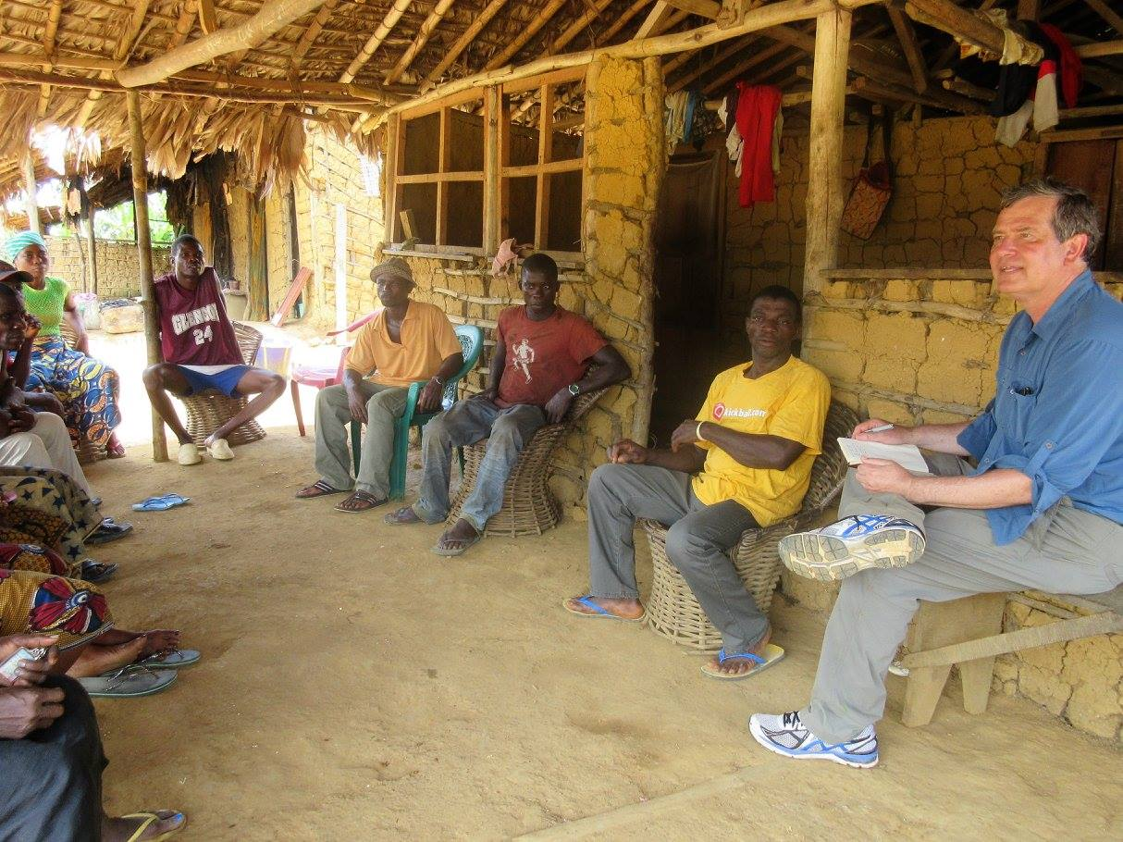
Triangulation
Identifying Gaps
Aligning viewpoints
Take photos
Conduct repeat visits
Ask interviewees to respond to statements from other (unnamed) interviewees

Slide 23
Field-based HRIA
Screening
Scoping
Field-based HRIA
Management and Monitoring
Mitigation Action Plan
Aggregated data
Acquire Righst-holder Views
Identify Gaps
Rate Impacts
Aggregate Data
Cataloging and interviewing
Acquiring Rightsholder Views
Train your guide
Plan a sampling Strategy
Test your questions
Identifying Gaps
Triangulation
Rating Impacts
Scoring process

Slide 24
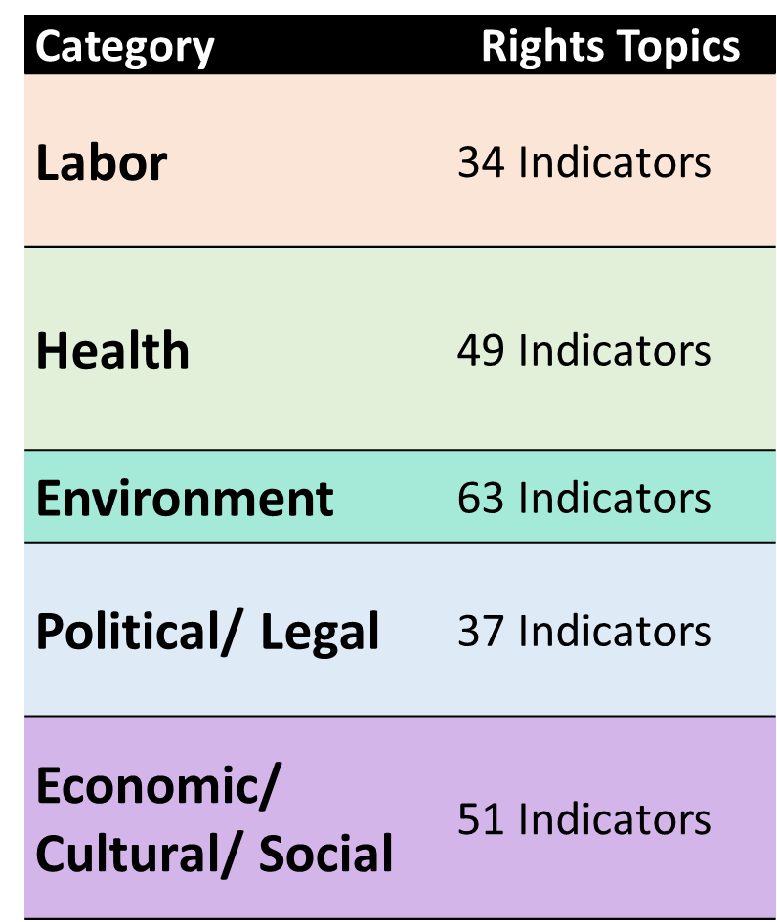
Scoring
Intensity
Extent
 | Scores
Context | Workers lived with families – no | -0-
 | Baseline dormitory conditions | -0-
Impact | No clean water provided– elevated local stream coliform levels | -5
 | 2.4 workers per bed | -25
 | 72 workers, 2 WCs: 36 workers/WC – WHO recommends 20 | -15
-15
0
-12 to -25
-0.5 to -12
0.5 to 12
12 to 25

Slide 25
Findings
Right | Green Resources | Dole | KLK
Right to Food
Right to Water (community/ workforce)
Right to a Clean Environment
First Rating
Agriculture is not up to the standards of extractives in environmental data collection or monitoring

Slide 26
Findings
Right | Green Resources | Dole | KLK
Right to Food
Right to Water (community/ workforce)
Right to a Clean Environment
Right to Favorable Working Conditions
Right to Belong to a Trade Union, Right to Strike
First Rating
Agriculture is not up to the standards of extractives in environmental data collection or monitoring
Labor risks are real where Legal frameworks fall short

Slide 27
Findings
Right | Green Resources | Dole | KLK
Right to Food
Right to Water (community/ workforce)
Right to a Clean Environment
Right to Favorable Working Conditions
Right to Belong to a Trade Union, Right to Strike
Right to Just Remuneration
Right to an Adequate Standard of Living (employees/ roadside inhabitants)
Right to Housing (Communities/ Dormitories
Right to Health (General/ HIV)
First Rating
Agriculture is not up to the standards of extractives in environmental data collection or monitoring
Labor risks are real where Legal frameworks fall short
Property rights and living standards are often a challenge

Slide 28
Findings
Right | Green Resources | Dole | KLK
Right to Food
Right to Water (community/ workforce)
Right to a Clean Environment
Right to Favorable Working Conditions
Right to Belong to a Trade Union, Right to Strike
Right to Just Remuneration
Right to an Adequate Standard of Living (employees/ roadside inhabitants)
Right to Housing (Communities/ Dormitories
Right to Health (General/ HIV)
First Rating
Agriculture is not up to the standards of extractives in environmental data collection or monitoring
Labor risks are real where Legal frameworks fall short
Property rights and living standards are often a challenge
Contractors pose major risks
Non-discrimination
Equal pay for equal work
Right to Property
Freedom from Child Labor

Slide 29
Findings
Right | Green Resources | Dole | KLK
Right to Food
Right to Water (community/ workforce)
Right to a Clean Environment
Right to Favorable Working Conditions
Right to Belong to a Trade Union, Right to Strike
Right to Just Remuneration
Right to an Adequate Standard of Living (employees/ roadside inhabitants)
Right to Housing (Communities/ Dormitories
Right to Health (General/ HIV)
Non-discrimination
Equal pay for equal work
Right to Property
Freedom from Child Labor
First Rating
Misguided overreliance on sustainability certifications and memberships
Misinterpretation of Multi-Stakeholder Alliances
Notes:
This is enormously problematic, both from a human rights risk perspective and from a corporate risk perspective. Communities commonly misrepresent the nature of their grievances so that they are voiced in a way that garners public attention.
At KLK the environmental and water impacts may have been legitimate, but KLK doesn’t know because it doesn’t have data. Sometimes communities claim environmental harm, but they really need to have a discussion about livelihoods, or about poor access to healthcare, or about land stresses. It’s vitally important for companies to understand the legitimacy of complaints in order to appropriately mitigate impacts. If a company revamps its environmental approaches because communities claim disingenuously that pollution is a problem, the environmental overhaul doesn’t actually solve the problem.

Slide 30
Mitigation & Management Dole
Screening
Scoping
Field-based HRIA
Management and Monitoring
Mitigation Action Plan
Improve water quality monitoring
Investigate dust and noise mitigation
Government involvement assured implementation.
$1m water treatment facility installed

Slide 31
Monitor Dole
Right | Dole Before | Dole After
Right to Food
Right to Water (community/ dormitory)
Right to a Clean Environment
Right to Favorable Working Conditions
Right to Belong to a Trade Union, Right to Strike
Right to Just Remuneration
Right to an Adequate Standard of Living (employees/ roadside inhabitants)
Right to Housing (communities)
Right to Health (General)
Non-discrimination
Equal pay for equal work
Right to Property
Freedom from Child Labor
Right to Privacy
Screening
Scoping
Field-based HRIA
Management and Monitoring
Mitigation Action Plan

Slide 32
Findings GRL
Right | Green Resources Before
Food
Water (community/ workforce)
Environment
Working Conditions
Unionization
Remuneration
Housing (Communities/ Dormitories
Health (General/ HIV)
Non-discrimination
Equal pay
Property
Child Labor
Screening
Scoping
Field-based HRIA
Management and Monitoring
Mitigation Action Plan

Slide 33
Mitigation & Management Green Resources
Screening
Scoping
Field-based HRIA
Management and Monitoring
Mitigation Action Plan
Transition workers from ‘contract’ positions
Supply PPE to all, document PPE purchases
Upgrade worker housing
Provide safe transport for workers to site
Provide access to healthcare including education, testing, contraceptives and treatment for HIV
Reinstate union workers
Increase wages to meet local cost of living
Train local residents for semiskilled jobs
Environmental Data requests

Slide 34
Monitor GRL
Right | Green Resources Before | Green Resources After
Food
Water (community/ workforce)
Environment
Working Conditions
Unionization
Remuneration
Housing (Communities/ Dormitories
Health (General/ HIV)
Non-discrimination
Equal pay
Property
Child Labor
Screening
Scoping
Field-based HRIA
Management and Monitoring
Mitigation Action Plan

Slide 35
Findings KLK
Right | KLK Before
Food
Water (community/ workforce)
Environment
Working Conditions
Unionization
Just Remuneration
Adequate Standard of Living (contractors/employees)
Housing
Health
Non-discrimination
Equal pay
Roperty
Child Labor
Screening
Scoping
Field-based HRIA
Management and Monitoring
Mitigation Action Plan

Slide 36
Mitigation & Management KLK
Screening
Transition workers from ‘contract’ positions
Supply PPE to all, document PPE purchases
Upgrade worker housing, Sanitation and Water
Investigate Child Labor Allegations
Environmental Data requests
Scoping
Field-based HRIA
Mitigation Action Plan
Management and Monitoring

Slide 37
Monitor KLK
Right | KLK Before | KLK After
Right to Food
Right to Water (community/ workforce)
Right to a Clean Environment
Right to Favorable Working Conditions
Right to Belong to a Trade Union, Right to Strike
Right to Just Remuneration
Right to an Adequate Standard of Living (contractors/employees)
Right to Housing
Right to Health
Non-discrimination
Equal pay for equal work
Right to Property
Freedom from Child Labor
Screening
Scoping
Field-based HRIA
Management and Monitoring
Mitigation Action Plan

Slide 38
Challenges
Transient Workforces
Weak Data
Corporate Opacity Reduces Responsiveness
Flawed Reliance on MSIs
Time and Financial Cost of HRIA

Slide 39
Thank You
Questions?

